Slide 1


Vibrant Living
Notes:
Photo of club
What innovations and technologies will enhance our culture and wellbeing? What role can music, data and technology play in ensuring connection and day-to-day happiness in a smart city?
Footer have both SmartBuildingMusic - Toronto

Slide 2

We help Torontonians Explore our City & New Artists at the same time.
Vibrant Living

Slide 3
We help Torontonians Explore our City & New Artists at the same time.
Vibrant Living

Slide 4
Why?
Vibrant Living

Slide 5
With over 10,000 areas it’s overwhelming to explore
Vibrant Living

Slide 6
With over 10,000 areas it’s overwhelming to explore
Vibrant Living

Slide 7
With over 10,000 Artists it’s hard to get your attention.
Vibrant Living

Slide 8
With over 10,000 Artists it’s hard to get your attention.
Vibrant Living

Slide 9

Meet
Vibrant Living

Slide 10

Using Geo-location, we serve New Areas to explore
Vibrant Living

Slide 11
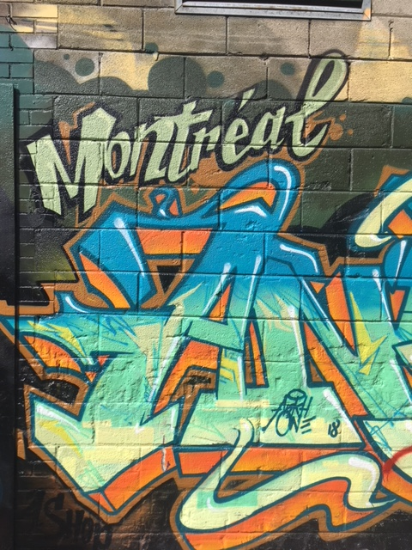
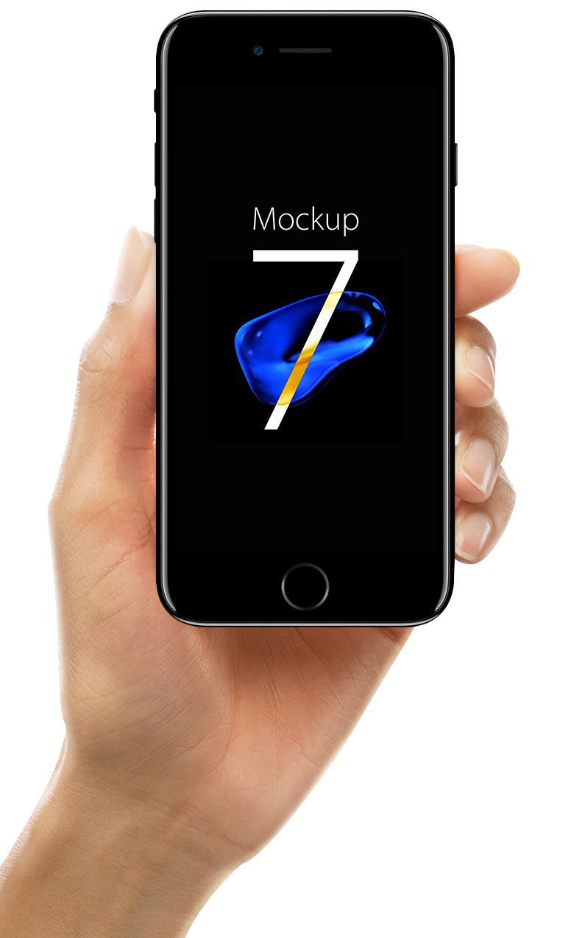

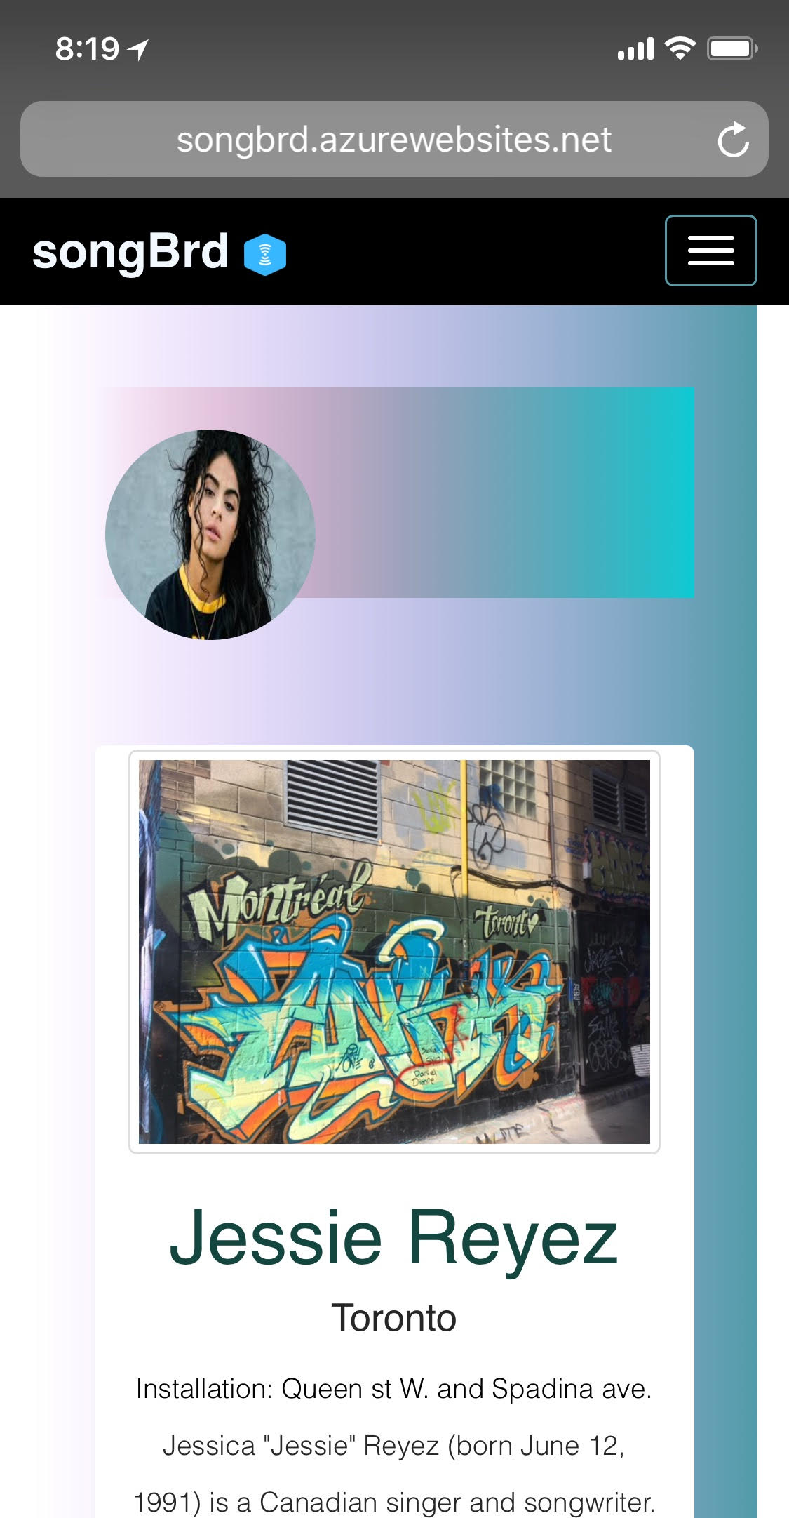


And New Artists that you’ll love with just a tap.
Vibrant Living
Vibrant Living
Notes:
Play song

Slide 12
How?
Vibrant Living

Slide 13
Artists can only select
one area and song per month
Vibrant Living
Notes:
On our platform….

Slide 14

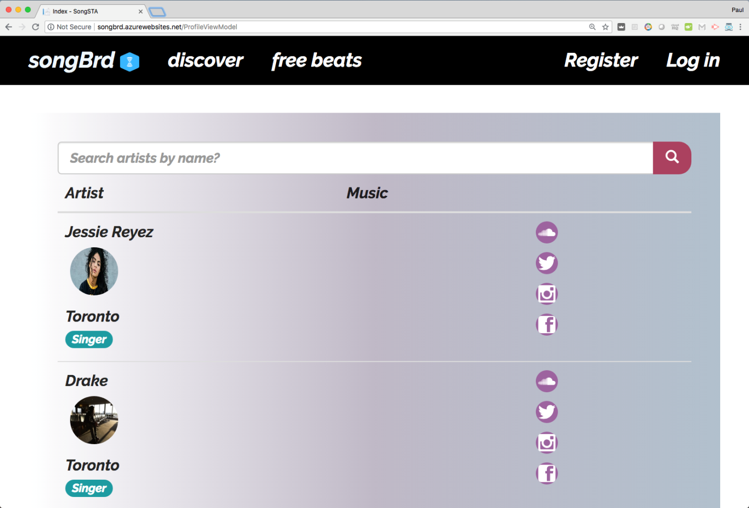
Vibrant Living
Notes:
Link that NFC URL goes to redirects for that artist during x time.

Slide 15

Privacy
Compliant with The Personal Information Protection and Electronic Documents Act (PIPEDA)
Privacy Act Canada and GDPR compliant.
Our platform stores data in Canada
Vibrant Living

Slide 16
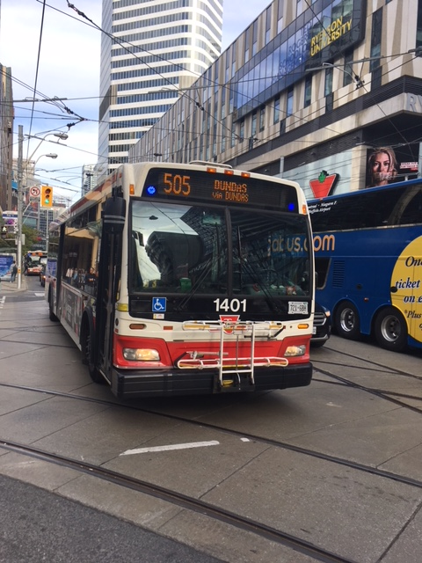
The Team
Mohamoud Mohamed - Coding
Greg Cook - Engineer
Paul Amendola – Product
Harrison Faulkner – UI/UX
Vibrant Living

Slide 17

Vibrant City is at the intersection of music and life
Vibrant Living
Notes:
Photo of club
What innovations and technologies will enhance our culture and wellbeing? What role can music, data and technology play in ensuring connection and day-to-day happiness in a smart city?
Footer have both SmartBuildingMusic - Toronto

Slide 18
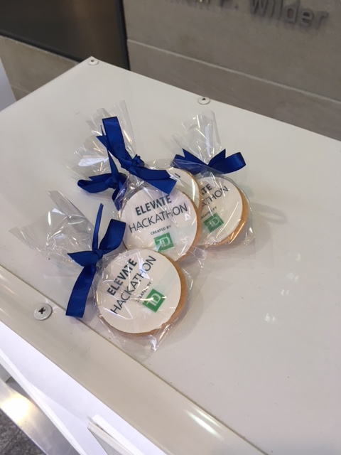
Thank you
Vibrant Living

